Slide 1

Deep Learning
Unit V – Deep Learning for Natural Language Processing
Lecture XX – Introduction to NLP
M Pardha Saradhi
Associate Professor
Department of Electronics and Communications Engineering
Vasireddy Venkatadri Institute of Technology
Nambur – 522508
pardhasaradhi@vvit.net
https://www.vvitguntur.com/
2023

Slide 2
Deep Learning | Unit III – DL for Computer Vision | Lecture XX – Introduction to NLP |
Contents | Use cases |
Saradhi | ECE
pardhasaradhi@vvit.net
Deep Learning for Natural Language Processing:
Computational representation of language, one-hot representation of words, word vectors – the skip-gram word2vec model, The CBOW word2vec model, word vector arithmetic, RNN, LSTM.
* My notes

Slide 3

Deep Learning | Unit III – DL for Computer Vision | Lecture XX – Introduction to NLP |
Contents | Use cases |
Saradhi | ECE
pardhasaradhi@vvit.net
Hand crafted features
Feature Extractor
Trainable Classifier
Traditional ML
Representations are hierarchical and learned automatically
Low Level Features
Mid Level Features
High Level Features
Trainable Classifier
Deep Learning
The networks have many levels of depth
Machine learns a hierarchy of representations
No feature extraction required
ENTIRE MACHINE IS TRAINABLE
* https://github.com/ecsplendid/deep-learning-sequences-talk/blob/master/talk.pdf

Slide 4
Deep Learning | Unit III – DL for Computer Vision | Lecture XX – Introduction to NLP |
Contents | Use cases |
Saradhi | ECE
pardhasaradhi@vvit.net
Unlike other shallow ML algorithms; you can map between data domains
We learn a spatial as well as temporal transformation between the two
SEQUENCES
SEQUENCES
IMAGES
IMAGES
LANGUAGE
LANGUAGE
SPEECH
SPEECH
[…]
[…]
UNIVERSAL FUNCTION APPROXIMATORS
* https://github.com/ecsplendid/deep-learning-sequences-talk/blob/master/talk.pdf
Notes:
Before, in the days of shallow learning algorithms, we had very specialised algorithms for each predictive task.
[FREE] hidden markov models
NNs can handle any predictive task and are composable.
Paper cup analogy
Can map from the time domain into the space domain and vice versa

Slide 5
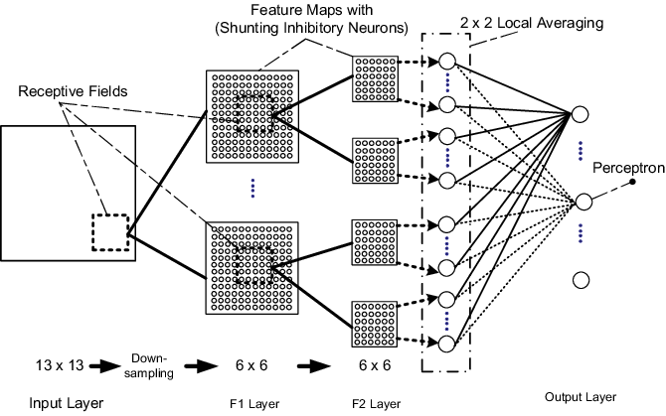

Deep Learning | Unit III – DL for Computer Vision | Lecture XX – Introduction to NLP |
Contents | Use cases |
Saradhi | ECE
pardhasaradhi@vvit.net
Unlike other algorithms, NNs can natively encode useful and obvious relationships in the data domain
Local spatial dependencies (vision)
Time dependencies (language, speech)
Convolutional Neural Networks
Recurrent Neural Networks
NATIVE DATA-DOMAIN FEATURES
* https://github.com/ecsplendid/deep-learning-sequences-talk/blob/master/talk.pdf
Notes:
[FREE] In the old days, detect dog in image, SVM…
The kind of thing you would be doing as a domain expert is applying various types of 2d convolution filtering to the image
In CNNs, the convolution filters are learned as part of the training process!
Traditional shallow learning algorithms had no concept of your how your input data was related, spatially or temporally.
You could quite literally randomly shuffle the data in the input space, and the algorithm would produce largely the same result (depending on whether the data was identically distributed and the algorithm was deterministic etc).
Use FFT example music
Plenty of domains care a lot about the relationships between items of data, take images for example which have a local spatial dependencies. Pixels are clearly related to ones in the vicinity. And language, words are clearly related to those in the vicinity. Before we had to do some manual hacks to transform the data outside of the time or space domain; like applying some feature extraction to images, or capturing N-grams for language. Neural networks can understand the data domain natively and build features from it dynamically as part of the training process.
The three families of network architectures that you should be familiar with are densely-connected networks, convolutional networks, and recurrent networks.

Slide 6

Deep Learning | Unit III – DL for Computer Vision | Lecture XX – Introduction to NLP |
Contents | Use cases |
Saradhi | ECE
pardhasaradhi@vvit.net
Composability
Deep Learning research is very applied
Accessibility
Software analogy
* https://github.com/ecsplendid/deep-learning-sequences-talk/blob/master/talk.pdf
Notes:
Talk about composability
There is a massive parallel with software here, DL is becoming a new form of software development and most of its practitioners have a software background not an academic background. You don’t need to be a scientist or a mathematician to do deep learning
Before --- different domains of ML would have their own specialised algorithms, modalities and execution contexts, and there would be a lot of glue code performing feature extraction and wiring up the components. Now the end-to-end prediction architectures can be described as a computation graph in any deep learning library
The people who work on DL tend to be software type people
Pre-existing deep learning components can be composed together in an entirely new way, like existing software development.
Language generating RNN example
On the Lego analogy; ideologically; this is where deep learning should be and will be, but isn’t quite there yet. We still don’t have the interoperability we want between frameworks for example.

Slide 7
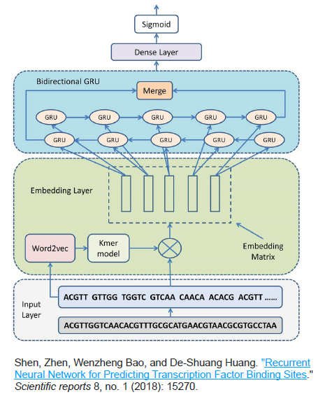
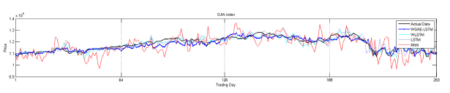
Deep Learning | Unit III – DL for Computer Vision | Lecture XX – Introduction to NLP |
Contents | Use cases |
Saradhi | ECE
pardhasaradhi@vvit.net
Sequence: Example Sequence modelling problems
Stock Market Prediction
DNA or (amino acid/protein) sequence modelling
*08_natural_language_processing_in_tensorflow.ppt

Slide 8
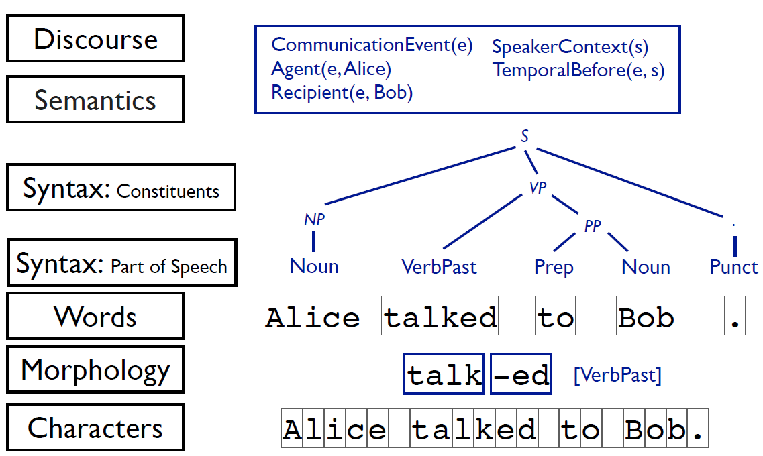
Deep Learning | Unit III – DL for Computer Vision | Lecture XX – Introduction to NLP |
Contents | Use cases |
Saradhi | ECE
pardhasaradhi@vvit.net
Levels of linguistic structure
*08_natural_language_processing_in_tensorflow.ppt

Slide 9
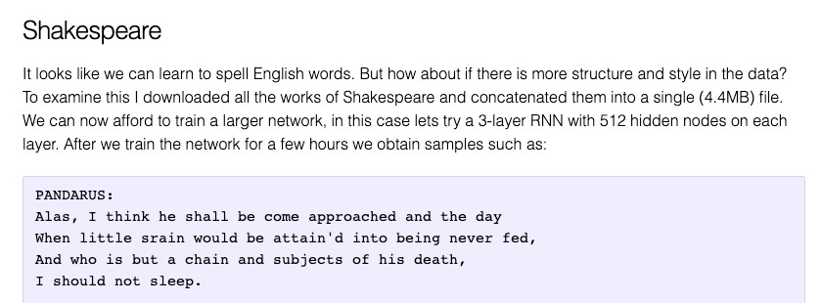
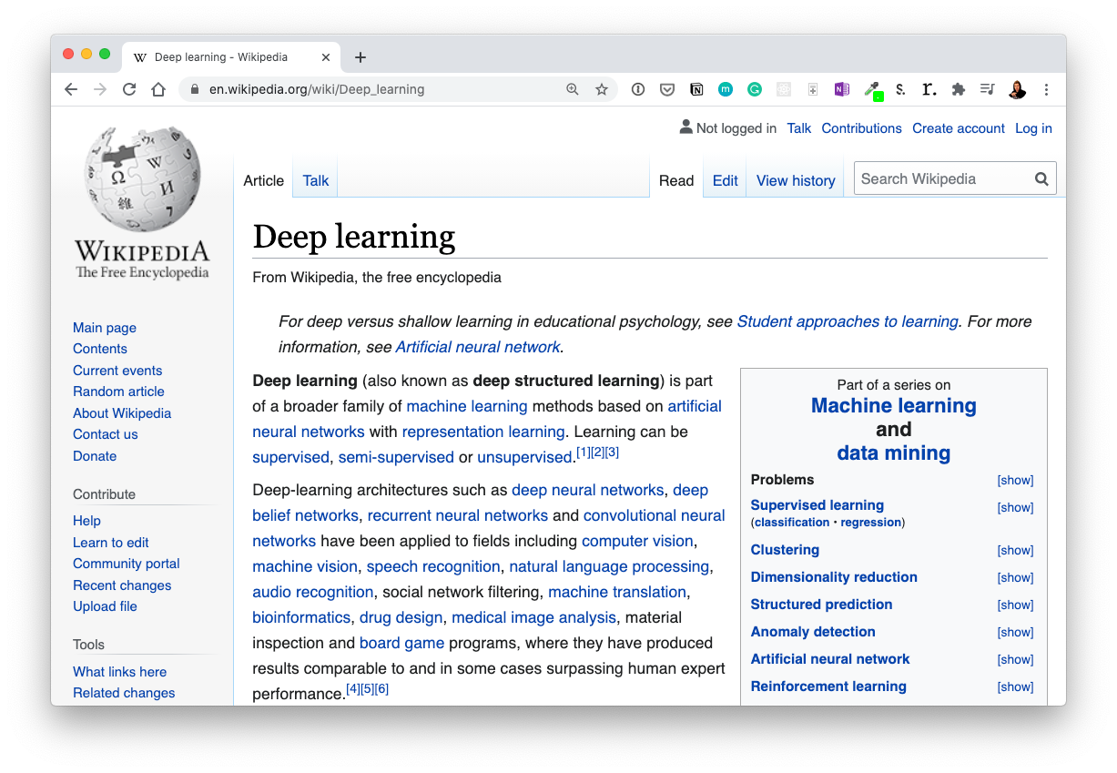
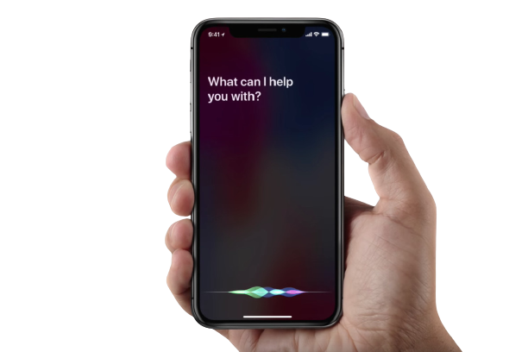

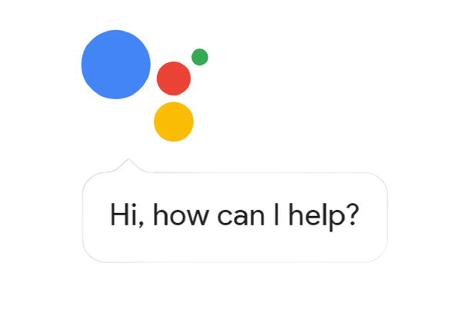
Deep Learning | Unit III – DL for Computer Vision | Lecture XX – Introduction to NLP |
Contents | Use cases |
Saradhi | ECE
pardhasaradhi@vvit.net
What is NLP? Example NLP problems
and NLU… (natural language understanding)
“What tags should this article have?”
Machine learning Representation learning Artificial intelligence
(multiple label options per sample)
Text Generation
Source: http://karpathy.github.io/2015/05/21/rnn-effectiveness/
These are also
referred to as sequence problems
Classification
Machine Translation
Voice Assistants
*08_natural_language_processing_in_tensorflow.ppt

Slide 10
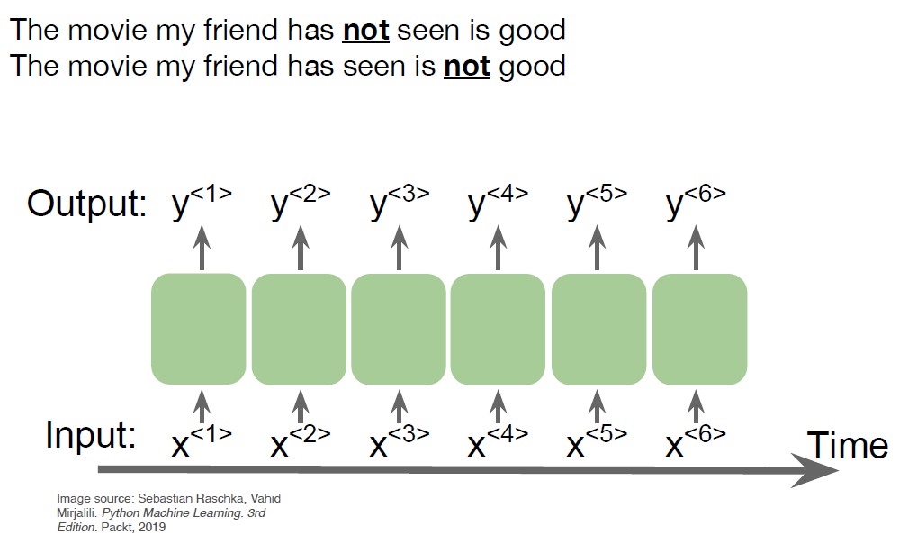
Deep Learning | Unit III – DL for Computer Vision | Lecture XX – Introduction to NLP |
Contents | Use cases |
Saradhi | ECE
pardhasaradhi@vvit.net
What is NLP?
NLP is a Sequence modelling problem
languages that evolved naturally through human use
e.g., Spanish, English, Arabic, Hindi, etc.
NOT: controlled languages (e.g., Klingon)
NOT: programming languages
Supervised learning: map text to X
Unsupervised learning: learn X from text
Generate: text from X
*08_natural_language_processing_in_tensorflow.ppt

Slide 11
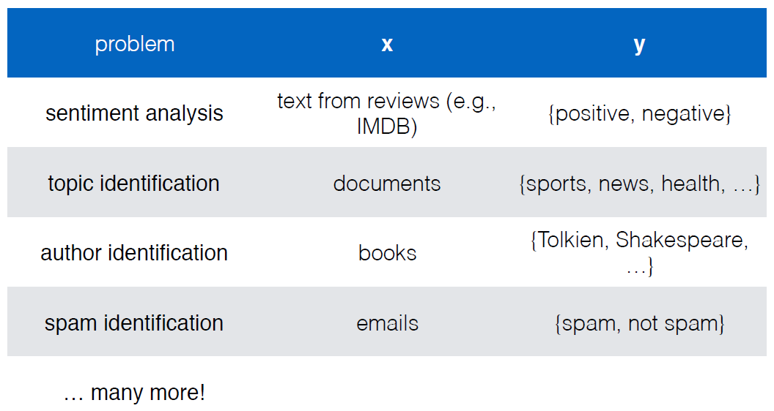
Deep Learning | Unit III – DL for Computer Vision | Lecture XX – Introduction to NLP |
Contents | Use cases |
Saradhi | ECE
pardhasaradhi@vvit.net
Text classification
• input: some text x (e.g., sentence, document)
• output: a label y (from a finite label set)
• goal: learn a mapping function f from x to y
fyi: basically every NLP problem
reduces to learning a mapping function
with various definitions of x and y!
*

Slide 12
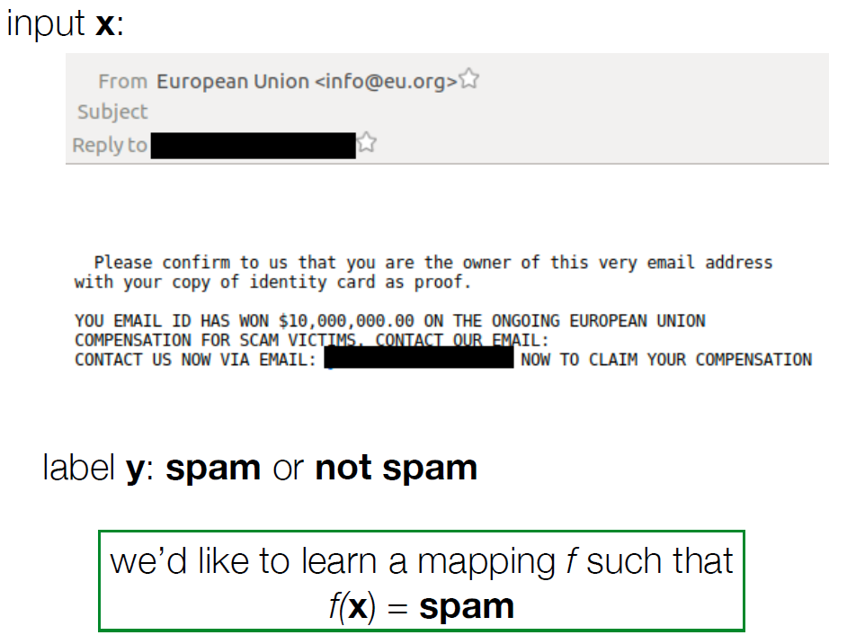
Deep Learning | Unit III – DL for Computer Vision | Lecture XX – Introduction to NLP |
Contents | Use cases |
Saradhi | ECE
pardhasaradhi@vvit.net
Text classification
f can be hand-designed rules
• if “won $10,000,000” in x, y = spam
• if “CS585 Fall 2019” in x, y = not spam
what are the drawbacks of this method?
f can be learned from data
• given training data (already-labeled x,y pairs)
learn f by maximizing the likelihood of the
training data
• this is known as supervised learning
*

Slide 13
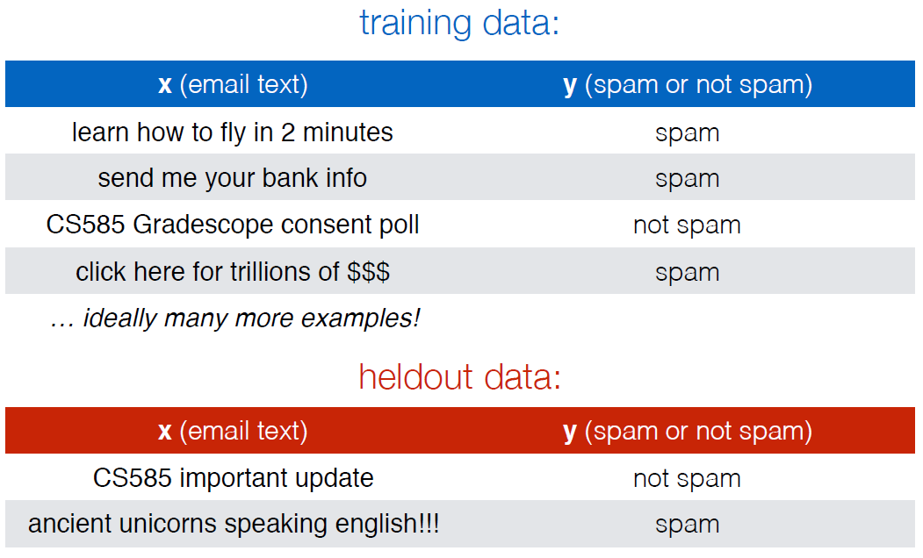
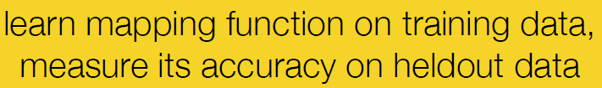
Deep Learning | Unit III – DL for Computer Vision | Lecture XX – Introduction to NLP |
Contents | Use cases |
Saradhi | ECE
pardhasaradhi@vvit.net
Text classification
*

Slide 14
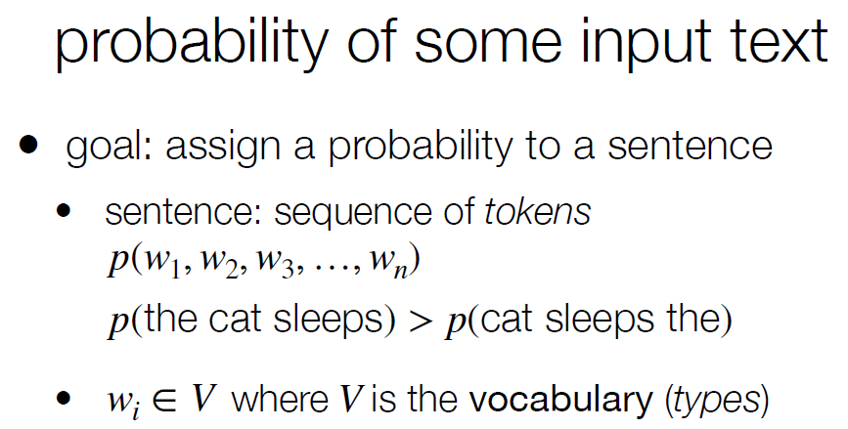
Deep Learning | Unit III – DL for Computer Vision | Lecture XX – Introduction to NLP |
Contents | Use cases |
Saradhi | ECE
pardhasaradhi@vvit.net
Representation of Text | Bag-Of-Words
*

Slide 15
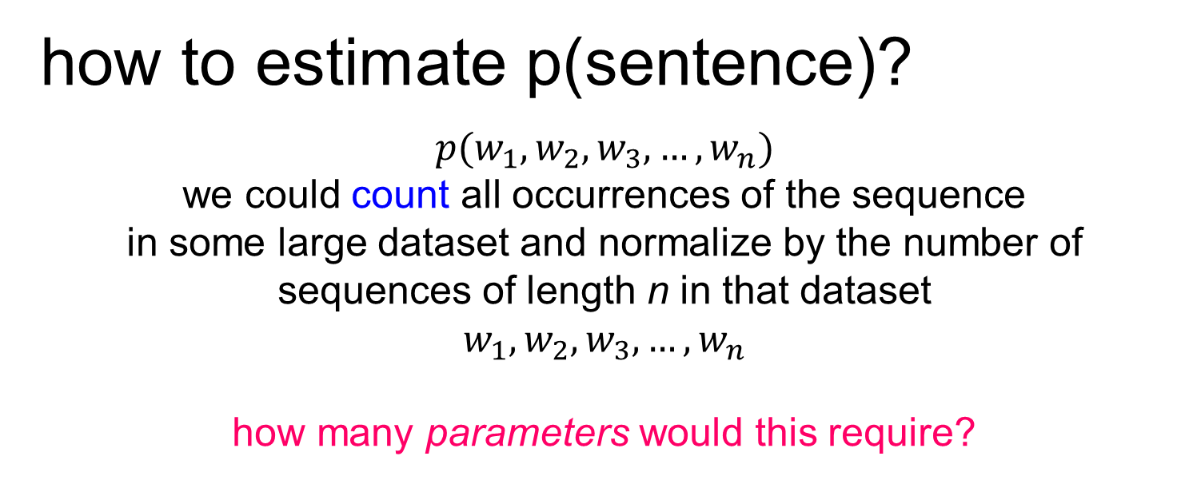
Deep Learning | Unit III – DL for Computer Vision | Lecture XX – Introduction to NLP |
Contents | Use cases |
Saradhi | ECE
pardhasaradhi@vvit.net
Representation of Text | Bag-Of-Words
how to estimate p(sentence)?
$$p(w_{1},w_{2},w_{3},…,w_{n})$$
we could count all occurrences of the sequence
in some large dataset and normalize by the number of
sequences of length n in that dataset
$$w_{1},w_{2},w_{3},…,w_{n}$$
how many parameters would this require?
Wikipedia
*

Slide 16
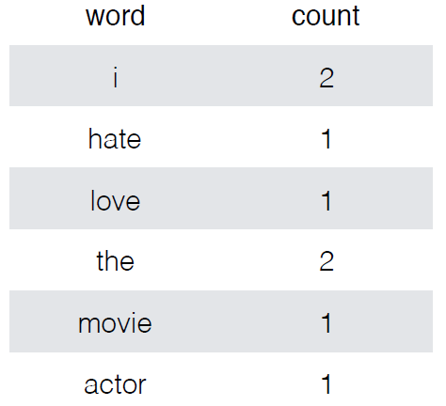
Deep Learning | Unit III – DL for Computer Vision | Lecture XX – Introduction to NLP |
Contents | Use cases |
Saradhi | ECE
pardhasaradhi@vvit.net
Representation of Text | Bag-Of-Words | Example of Text classification
i hate the actor i love the movie
equivalent representation to:
actor i i the love the movie hate
*

Slide 17
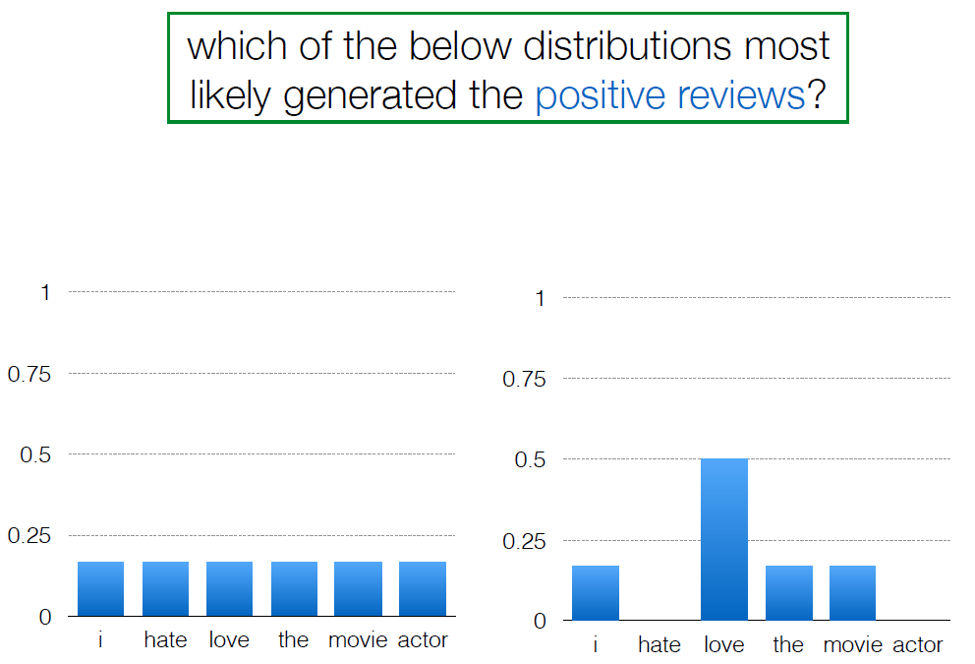
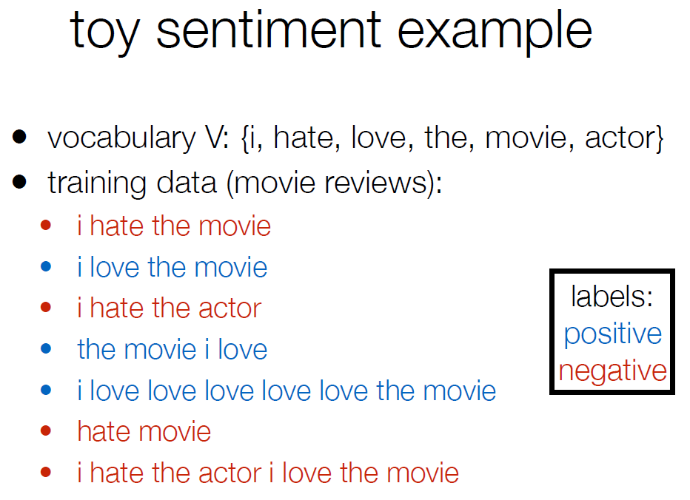
Deep Learning | Unit III – DL for Computer Vision | Lecture XX – Introduction to NLP |
Contents | Use cases |
Saradhi | ECE
pardhasaradhi@vvit.net
Representation of Text | Bag-Of-Words | Example of Text classification
models that estimate p(text) are called language models. we will be seeing a lot of these in the rest of the class. naive Bayes uses a unigram language model, which is the
simplest possible LM.
*

Slide 18
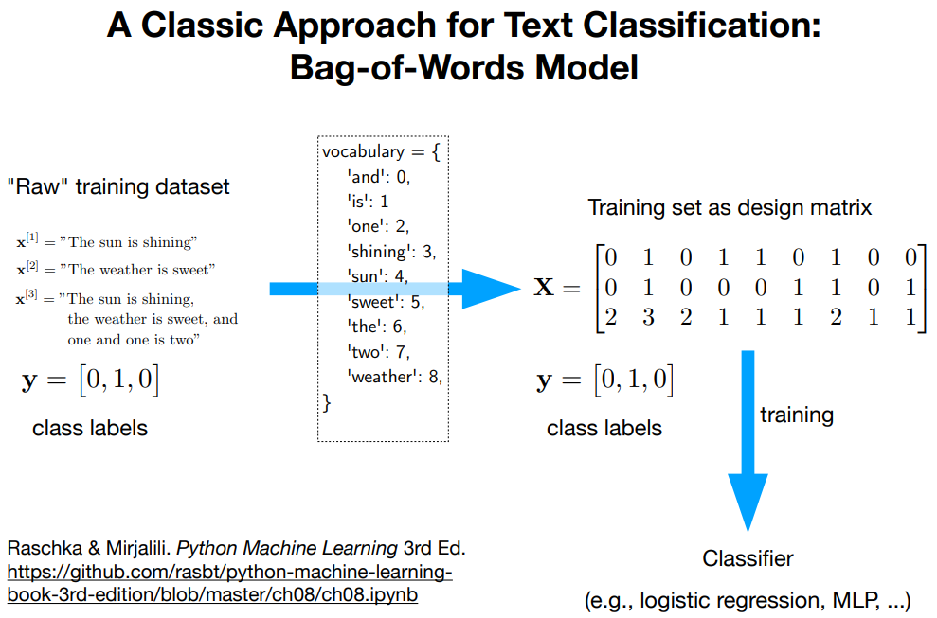
Deep Learning | Unit III – DL for Computer Vision | Lecture XX – Introduction to NLP |
Contents | Use cases |
Saradhi | ECE
pardhasaradhi@vvit.net
Representation of Text | Bag-Of-Words
*

Slide 19
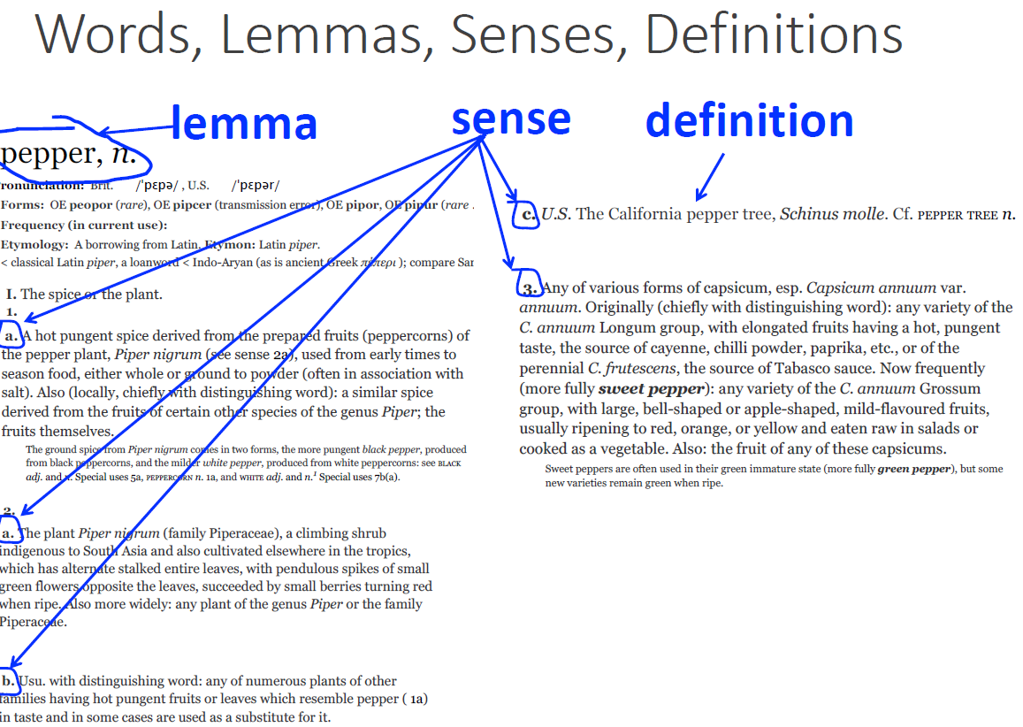
Deep Learning | Unit III – DL for Computer Vision | Lecture XX – Introduction to NLP |
Contents | Use cases |
Saradhi | ECE
pardhasaradhi@vvit.net
Representation of Text
Levels of linguistic structure
What do words mean?
First thought: look in a dictionary
*

Slide 20
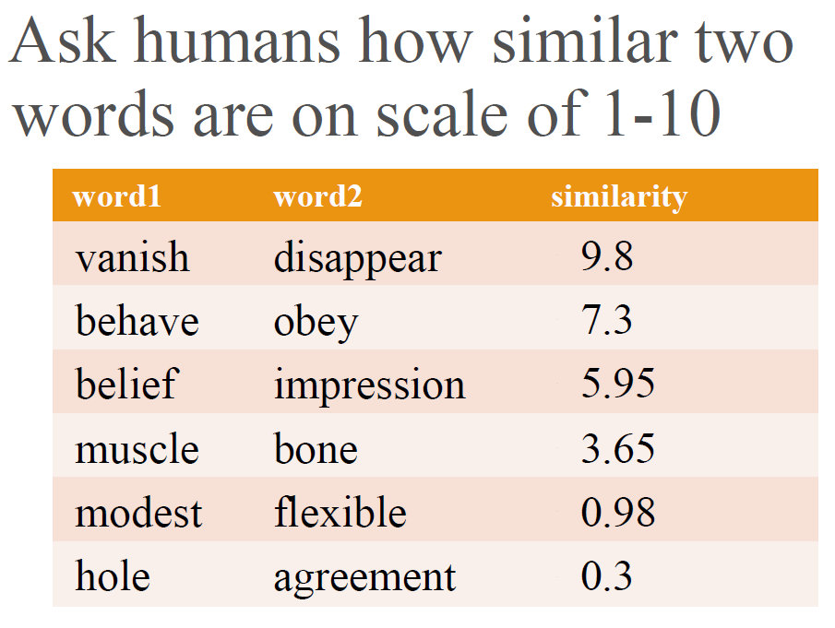
Deep Learning | Unit III – DL for Computer Vision | Lecture XX – Introduction to NLP |
Contents | Use cases |
Saradhi | ECE
pardhasaradhi@vvit.net
Relation: Similarity
Words with similar meanings. Not
synonyms, but sharing some element of
meaning
car, bicycle
cow, horse
Representation of Text:
Relation: Synonymity
Synonyms have the same meaning in some
or all contexts.
◦ couch / sofa
◦ big / large
◦ automobile / car
◦ vomit / throw up
◦ Water / H20
Relation: Antonymy
Senses that are opposites with respect to one feature ofMeaning
Otherwise, they are very similar!
dark/light short/long fast/slow
rise/fall hot/cold up/down
in/out
SimLex- 999 dataset (Hill et al., 2015)
*

Slide 21
Deep Learning | Unit III – DL for Computer Vision | Lecture XX – Introduction to NLP |
Contents | Use cases |
Saradhi | ECE
pardhasaradhi@vvit.net
…in NLP, we commonly
represent word types
with vectors!
Representation of Text:
Word similarity for plagiarism detection
why use vectors to encode meaning?
computing the similarity between two words (or phrases, or documents) is extremely useful for many NLP tasks
Q: how tall is Mount Everest?
A: The official height of Mount Everest is 29029 ft
*

Slide 22
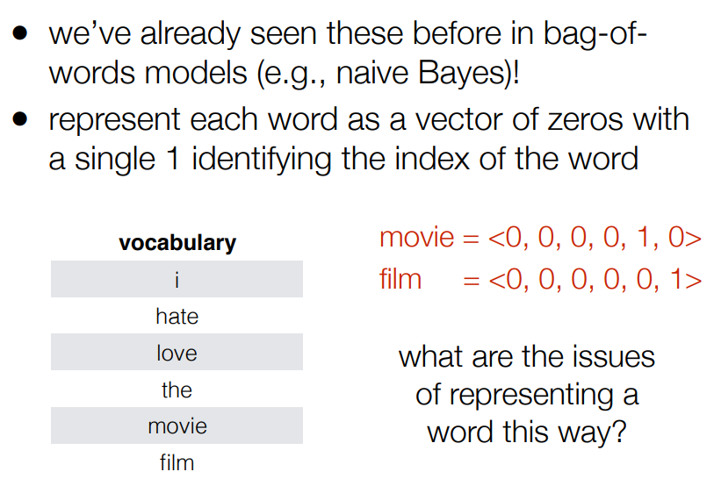
Deep Learning | Unit III – DL for Computer Vision | Lecture XX – Introduction to NLP |
Contents | Use cases |
Saradhi | ECE
pardhasaradhi@vvit.net
Representation of Text | One-hot vectors
all words are equally (dis)similar!
21
movie = <0, 0, 0, 0, 1, 0>
film = <0, 0, 0, 0, 0, 1>
dot product is zero!
these vectors are orthogonal
How can we compute a vector representation such that the dot product correlates with word similarity?
* https://people.cs.umass.edu/~miyyer/cs585/lectures/05-wordemb.pdf

Slide 23
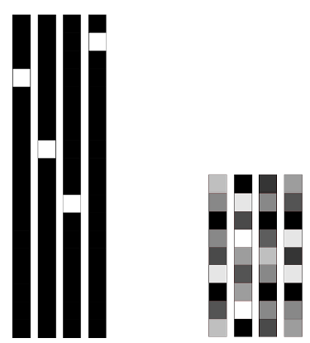
Deep Learning | Unit III – DL for Computer Vision | Lecture XX – Introduction to NLP |
Contents | Use cases |
Saradhi | ECE
pardhasaradhi@vvit.net
Representation of Text | One-hot word vectors vs Word embedding
One-hot word vectors vs Word embedding
Word embedding
word2vec
CBOW
Skipgrams
Sparse vectors
Higher dimensional
Hard coded
Dense vectors
Lower dimensional
Representation is created by training a classifier to distinguish nearby and far-away words
Very fast to train
Idea: predict rather than count
* https://people.cs.umass.edu/~miyyer/cs585/lectures/05-wordemb.pdf

Slide 24
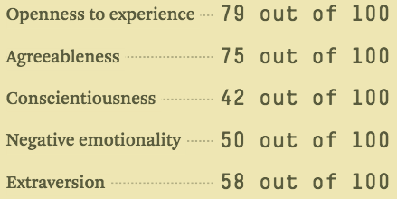
Deep Learning | Unit III – DL for Computer Vision | Lecture XX – Introduction to NLP |
Contents | Use cases |
Saradhi | ECE
pardhasaradhi@vvit.net
Representation of Text | Word embedding | word2vec
Word embeddings is the concept of representing text and words as vectors of numbers that capture their meanings.
Word2vec is a method that was published in 2013
Companies like Airbnb, Alibaba, Spotify, and Anghami have all benefitted by this word2vec method
Example: Personality Embeddings-What are you like?
Did you know that a list of five numbers (a vector) can represent so much about your personality?
We can represent people (and things) as vectors of numbers (which is great for machines!).
We can easily calculate how similar vectors are to each other.
* https://proceedings.neurips.cc/paper/2013/file/9aa42b31882ec039965f3c4923ce901b-Paper.pdf | https://jalammar.github.io/illustrated-word2vec/ | https://www.youtube.com/watch?v=ISPId9Lhc1g&ab_channel=JayAlammar |
Notes:
On a scale of 0 to 100, how introverted/extraverted are you (where 0 is the most introverted, and 100 is the most extraverted)? Have you ever taken a personality test like MBTI – or even better, the Big Five Personality Traits test? If you haven’t, these are tests that ask you a list of questions, then score you on a number of axes, introversion/extraversion being one of them.

Slide 25
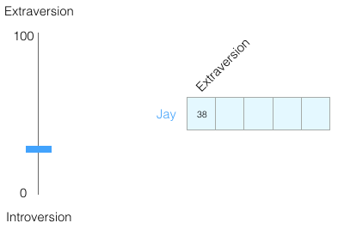
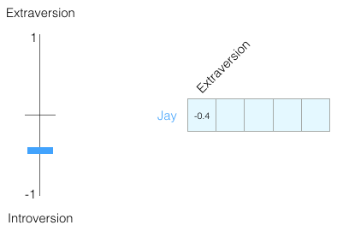
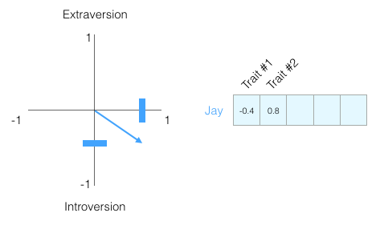
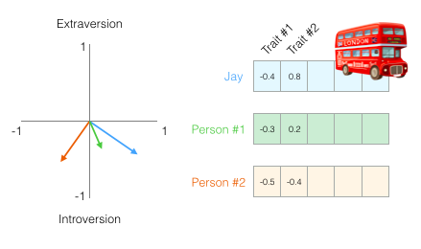
Deep Learning | Unit III – DL for Computer Vision | Lecture XX – Introduction to NLP |
Contents | Use cases |
Saradhi | ECE
pardhasaradhi@vvit.net
Word2vec |Example: Personality Embeddings-What are you like?
After switching the range to be from -1 to 1
* https://proceedings.neurips.cc/paper/2013/file/9aa42b31882ec039965f3c4923ce901b-Paper.pdf | https://jalammar.github.io/illustrated-word2vec/ | https://www.youtube.com/watch?v=ISPId9Lhc1g&ab_channel=JayAlammar |
Notes:
On a scale of 0 to 100, how introverted/extraverted are you (where 0 is the most introverted, and 100 is the most extraverted)? Have you ever taken a personality test like MBTI – or even better, the Big Five Personality Traits test? If you haven’t, these are tests that ask you a list of questions, then score you on a number of axes, introversion/extraversion being one of them.

Slide 26
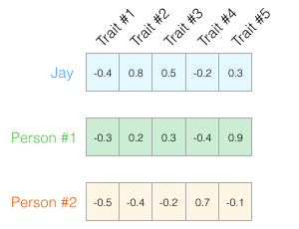
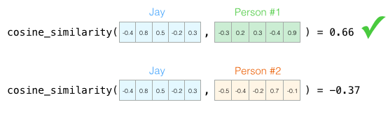
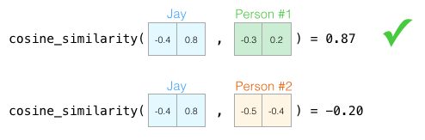
Deep Learning | Unit III – DL for Computer Vision | Lecture XX – Introduction to NLP |
Contents | Use cases |
Saradhi | ECE
pardhasaradhi@vvit.net
Word2vec |Example: Personality Embeddings-What are you like?
Jay needed to be replaced by someone with a similar personality. In the figure, which of the two people is more similar to Jay?
* https://proceedings.neurips.cc/paper/2013/file/9aa42b31882ec039965f3c4923ce901b-Paper.pdf | https://jalammar.github.io/illustrated-word2vec/ | https://www.youtube.com/watch?v=ISPId9Lhc1g&ab_channel=JayAlammar |
Notes:
On a scale of 0 to 100, how introverted/extraverted are you (where 0 is the most introverted, and 100 is the most extraverted)?
Have you ever taken a personality test like MBTI – or even better, the Big Five Personality Traits test?
If you haven’t, these are tests that ask you a list of questions, then score you on a number of axes, introversion/extraversion being one of them.

Slide 27
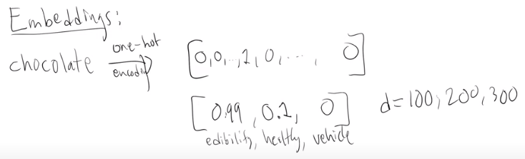
Deep Learning | Unit III – DL for Computer Vision | Lecture XX – Introduction to NLP |
Contents | Use cases |
Saradhi | ECE
pardhasaradhi@vvit.net
Word2vec |Example: Personality Embeddings-What are you like?
* https://proceedings.neurips.cc/paper/2013/file/9aa42b31882ec039965f3c4923ce901b-Paper.pdf | https://jalammar.github.io/illustrated-word2vec/ | https://www.youtube.com/watch?v=ISPId9Lhc1g&ab_channel=JayAlammar |
Notes:
On a scale of 0 to 100, how introverted/extraverted are you (where 0 is the most introverted, and 100 is the most extraverted)?
Have you ever taken a personality test like MBTI – or even better, the Big Five Personality Traits test?
If you haven’t, these are tests that ask you a list of questions, then score you on a number of axes, introversion/extraversion being one of them.

Slide 28
Deep Learning | Unit III – DL for Computer Vision | Lecture XX – Introduction to NLP |
Contents | Use cases |
Saradhi | ECE
Word embedding
pardhasaradhi@vvit.net
Word2vec | training setup
Let's represent words as vectors of some length (say 300), randomly initialized.
So we start with 300 * V random parameters
Over the entire training set, we’d like to adjust those word vectors such that we
Maximize the similarity of the target word, context word pairs (t,c) drawn from the positive data
Minimize the similarity of the (t,c) pairs drawn from the negative data.
word2vec
CBOW
Skipgrams
Target is learned
Context vectors are learned
Both target and context vectors are learned, so we have no explicit featurization!
*

Slide 29
Deep Learning | Unit III – DL for Computer Vision | Lecture XX – Introduction to NLP |
Contents | Use cases |
Saradhi | ECE
Word embedding
pardhasaradhi@vvit.net
Word2vec | training setup | CBOW
Training sentence:
... lemon, a tablespoon of apricot jam a pinch ...
c1 c2 target c3 c4
9/7/18
Assume context words are those in +/- 2 word window
word2vec
CBOW
Skipgrams
Target is learned
Context vectors are learned
Context vector1
Word embedding
Context vector2
Target vector
Model
Target vector
Both target and context vectors are learned, so we have no explicit featurization!
Context vector3
Context vector4
*

Slide 30
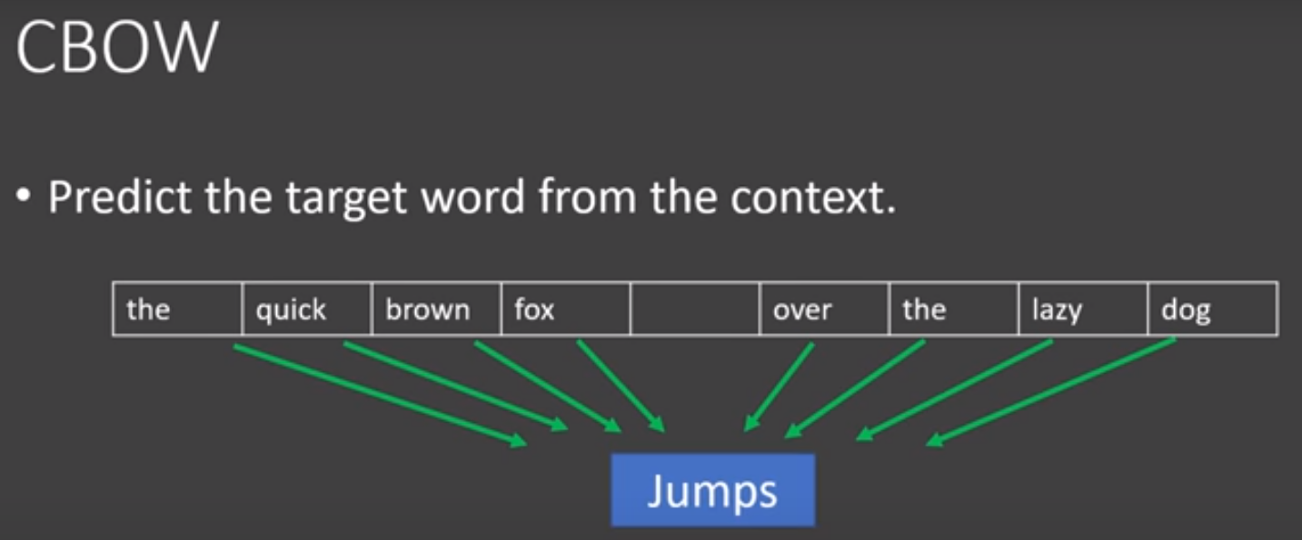
Deep Learning | Unit III – DL for Computer Vision | Lecture XX – Introduction to NLP |
Contents | Use cases |
Saradhi | ECE
Word embedding
pardhasaradhi@vvit.net
Word2vec | training setup | CBOW
Training sentence:
... lemon, a tablespoon of apricot jam a pinch ...
c1 c2 target c3 c4
9/7/18
Assume context words are those in +/- 2 word window
word2vec
CBOW
Skipgrams
Target is learned
Context vectors are learned
Both target and context vectors are learned, so we have no explicit featurization!
*

Slide 31
Deep Learning | Unit III – DL for Computer Vision | Lecture XX – Introduction to NLP |
Contents | Use cases |
Saradhi | ECE
Word embedding
pardhasaradhi@vvit.net
Word2vec | training setup | Skipgram
Training sentence:
... lemon, a tablespoon of apricot jam a pinch ...
c1 c2 target c3 c4
9/7/18
Assume context words are those in +/- 2 word window
word2vec
CBOW
Skipgrams
Target is learned
Context vectors are learned
Context vector1
Context vector1
Context vector2
Context vector2
Target vector
Model
Target vector
Both target and context vectors are learned, so we have no explicit featurization!
Context vector3
Context vector3
Context vector4
Context vector4
Word embedding
*

Slide 32
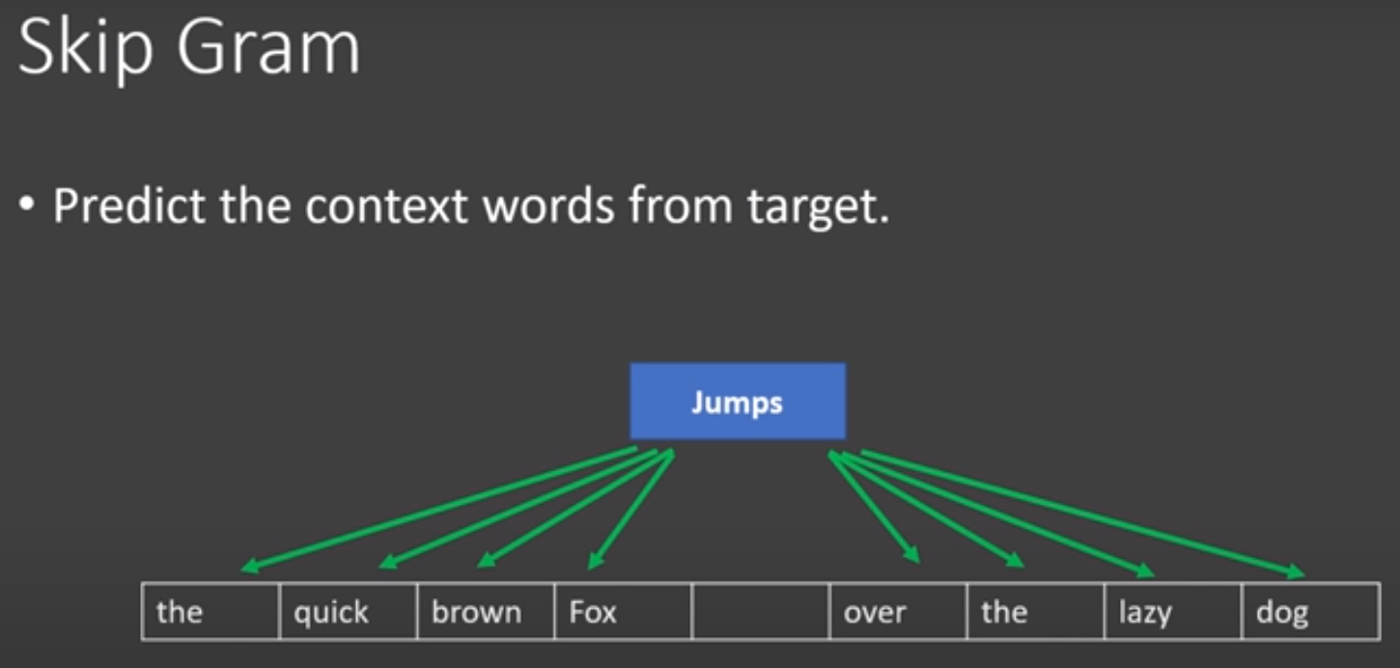
Deep Learning | Unit III – DL for Computer Vision | Lecture XX – Introduction to NLP |
Contents | Use cases |
Saradhi | ECE
Word embedding
pardhasaradhi@vvit.net
Word2vec | training setup | Skipgram
Training sentence:
... lemon, a tablespoon of apricot jam a pinch ...
c1 c2 target c3 c4
9/7/18
Assume context words are those in +/- 2 word window
word2vec
CBOW
Skipgrams
Target is learned
Context vectors are learned
Both target and context vectors are learned, so we have no explicit featurization!
*

Slide 33
Deep Learning | Unit III – DL for Computer Vision | Lecture XX – Introduction to NLP |
Contents | Use cases |
Saradhi | ECE
Word embedding
pardhasaradhi@vvit.net
Word2vec | training setup
word2vec
From a large source of text (e.g., Wikipedia), generate positive examples by pairing a target word with a word in its neighboring context.
Create negative examples for the context words by randomly sampling other words in the vocabulary.
Train a logistic regression model to identify whether a given pair of words is a positive or negative example.
Use the weights of this model as the embeddings
CBOW
Skipgrams
Target is learned
Context vectors are learned
Both target and context vectors are learned, so we have no explicit featurization!
*

Slide 34
Deep Learning | Unit III – DL for Computer Vision | Lecture XX – Introduction to NLP |
Contents | Use cases |
Saradhi | ECE
Word embedding
pardhasaradhi@vvit.net
Word2vec | training setup | Example
Training sentence:
... lemon, a tablespoon of apricot jam a pinch ...
c1 c2 target c3 c4
9/7/18
Assume context words are those in +/- 2 word window
word2vec
CBOW
Skipgrams
Target is learned
Context vectors are learned
Given a tuple (t, c) = target, context
(apricot, jam)
(apricot, aardvark)
Return probability that c is a real context word:
P(+|t,c)
P(−|t,c) = 1−P(+|t,c)
Both target and context vectors are learned, so we have no explicit featurization!
*

Slide 35
Deep Learning | Unit III – DL for Computer Vision | Lecture XX – Introduction to NLP |
Contents | Use cases |
Saradhi | ECE
Word embedding
pardhasaradhi@vvit.net
Word2vec | training setup | Example
How to compute p(+|t,c)?
Intuition:
Words are likely to appear near similar words
Model similarity with dot-product!
Similarity(t,c) ∝ t ・ c
Problem:
Dot product is not a probability!
(Neither is cosine)
t and c here are vectors for target and context!
word2vec
CBOW
Skipgrams
Target is learned
Context vectors are learned
Both target and context vectors are learned, so we have no explicit featurization!
*

Slide 36
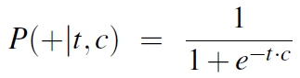
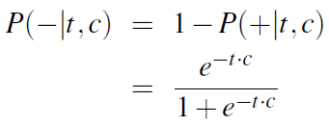
Deep Learning | Unit III – DL for Computer Vision | Lecture XX – Introduction to NLP |
Contents | Use cases |
Saradhi | ECE
Word embedding
pardhasaradhi@vvit.net
Word2vec | training setup | Example
Turning dot product into probability
word2vec
CBOW
Skipgrams
Target is learned
Context vectors are learned
Both target and context vectors are learned, so we have no explicit featurization!
*

Slide 37
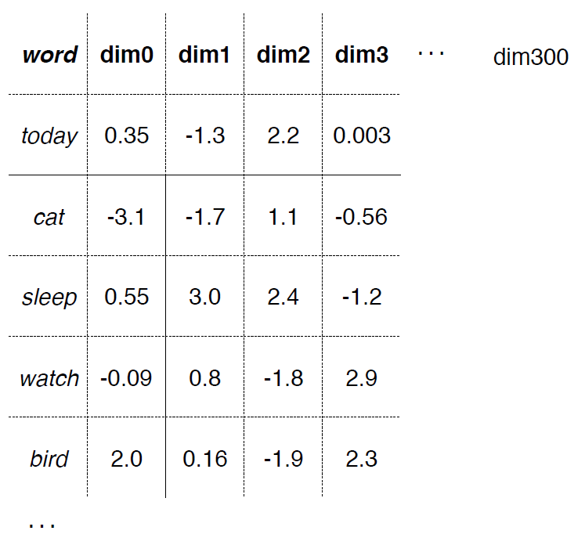
Deep Learning | Unit III – DL for Computer Vision | Lecture XX – Introduction to NLP |
Contents | Use cases |
Saradhi | ECE
pardhasaradhi@vvit.net
Word2vec | result
* https://people.cs.umass.edu/~miyyer/cs585/lectures/01-naive-bayes.pdf

Slide 38
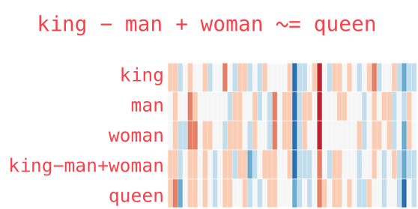
Deep Learning | Unit III – DL for Computer Vision | Lecture XX – Introduction to NLP |
Contents | Use cases |
Saradhi | ECE
pardhasaradhi@vvit.net
Word embedding | word2vec:
* https://proceedings.neurips.cc/paper/2013/file/9aa42b31882ec039965f3c4923ce901b-Paper.pdf | https://jalammar.github.io/illustrated-word2vec/ |

Slide 39
Deep Learning | Unit III – DL for Computer Vision | Lecture XX – Introduction to NLP |
Contents | Use cases |
Saradhi | ECE
pardhasaradhi@vvit.net
Word embedding | word2vec:
Analogy: Embeddings capture relational meaning!
vector(‘king’) - vector(‘man’) + vector(‘woman’) ≈ vector(‘queen’)
vector(‘Paris’) - vector(‘France’) + vector(‘Italy’) ≈ vector(‘Rome’)
* https://proceedings.neurips.cc/paper/2013/file/9aa42b31882ec039965f3c4923ce901b-Paper.pdf | https://jalammar.github.io/illustrated-word2vec/ |

Slide 40
Deep Learning | Unit III – DL for Computer Vision | Lecture XX – Introduction to NLP |
Contents | Use cases |
Saradhi | ECE
pardhasaradhi@vvit.net
Word embedding | word2vec:
* https://proceedings.neurips.cc/paper/2013/file/9aa42b31882ec039965f3c4923ce901b-Paper.pdf | https://jalammar.github.io/illustrated-word2vec/ |

Slide 41
Deep Learning | Unit III – DL for Computer Vision | Lecture XX – Introduction to NLP |
Contents | Use cases |
Saradhi | ECE
pardhasaradhi@vvit.net
Word embedding | word2vec:
* https://proceedings.neurips.cc/paper/2013/file/9aa42b31882ec039965f3c4923ce901b-Paper.pdf | https://jalammar.github.io/illustrated-word2vec/ |

Slide 42
Deep Learning | Unit III – DL for Computer Vision | Lecture XX – Introduction to NLP |
Contents | Use cases |
Saradhi | ECE
pardhasaradhi@vvit.net
Word embedding | word2vec:
Embeddings reflect cultural bias
Ask “Paris : France :: Tokyo : x”
◦ x = Japan
Ask “father : doctor :: mother : x”
◦ x = nurse
Ask “man : computer programmer :: woman : x”
◦ x = homemaker
huge concern for NLP systems deployed in
the real world that use embeddings!
* https://proceedings.neurips.cc/paper/2013/file/9aa42b31882ec039965f3c4923ce901b-Paper.pdf | https://jalammar.github.io/illustrated-word2vec/ |

Slide 43
Deep Learning | Unit III – DL for Computer Vision | Lecture XX – Introduction to NLP |
Contents | Use cases |
Saradhi | ECE
pardhasaradhi@vvit.net
What is a sequence?
* https://github.com/ecsplendid/deep-learning-sequences-talk/blob/master/talk.pdf

Slide 44
Digital Signal Processing | Unit V – Multirate Signal Processing | Lec54 – Sampling Rate Reduction by an Integer Factor
Saradhi | ECE
Introduction
pardhasaradhi@vvit.net
References
https://www.youtube.com/watch?v=ZmCzrPVzDQI&ab_channel=MachineLearningDojowithTimScarfe
Dsa
* My notes

Slide 45
Digital Signal Processing | Unit V – Multirate Signal Processing | Lec54 – Sampling Rate Reduction by an Integer Factor
Saradhi | ECE
D
pardhasaradhi@vvit.net
Next Lecture follows…
* My notes

